Slide 1
My Journey from Traditional to Contemporary Painting
By
Freda Lee-McCann

Slide 2
What is Traditional Chinese Landscape Painting?
Using Ink with brush on Rice Paper
Brush work is derived from Calligraphy and it is the focus
Transmit the spirit, not the appearance of nature
Create movement in the painting, invite the viewer on a journey to the inner world of the artist’s mind
Replacing representational forms with symbolic forms and abstractions
No perspective or vanishing point concept
More than one light source
Colors are muted often considered a distraction

Slide 3
Influenced by these Chinese Artists
Shi Tao ( 1642- 1707 )
Unique style and brushwork
C.P. Huang ( 1898-1991 )
Unique style and brushwork
C.C. Wang ( 1907-2003 )
Trained in classical Chinese painting
Created his personal contemporary style
Yu Cheng-Yao( 1898-1993 )
Untrained, unique, non-descriptive and densely layered
Li Hua-yi ( 1948-
Trained in Shanghai, Royal Academy in Brussels.
Bridging the gap between ‘traditional Chinese’ and ‘modern Western’
Yang Yong-Liang (1980-
Collage & Layering with photographs.

Slide 4
Shi Tao ( 1642- 1707 )

Slide 5
Shi Tao ( 1642- 1707 )

Slide 6
C.P. Huang ( 1898-1991 )

Slide 7
C.P. Huang ( 1898-1991 )

Slide 8
C.C. Wang ( 1907-2003 )

Slide 9
C.C. Wang ( 1907-2003 )

Slide 10
Li Hua-yi ( 1948-

Slide 11
Li Hua-yi ( 1948-

Slide 12
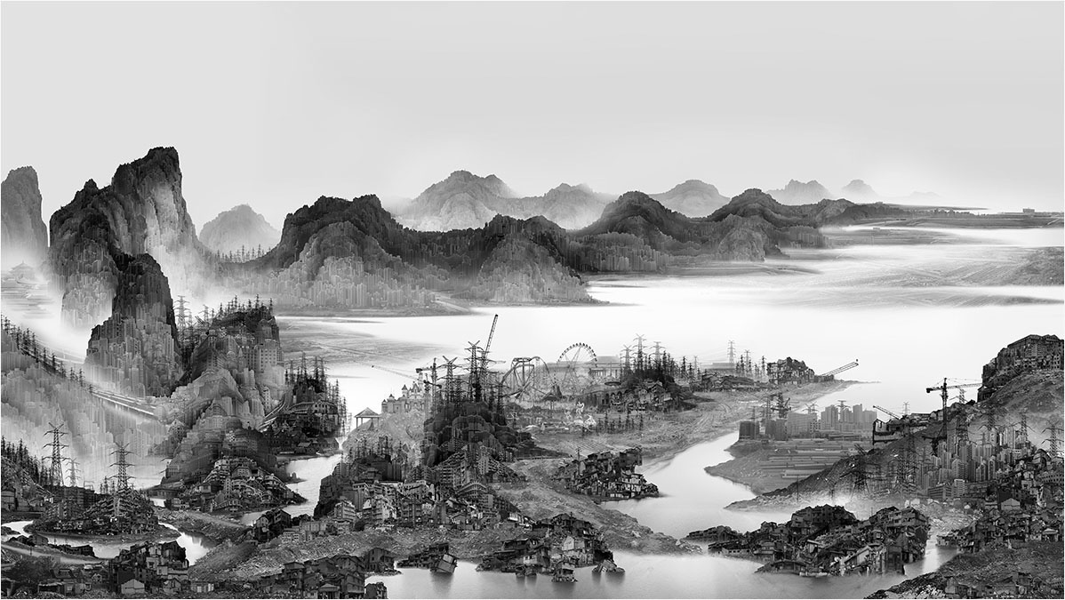
Yang Yong-Liang ( 1980-

Slide 13
Yang Yong-Liang ( 1980-

Slide 14
Painting by Shen Chou (1497) & Photo by Yang Yongliang (2009)

Slide 15
Influenced by these Western Artists
Robert Rauschenberg ( 1925-2008 )
Collage & Layering
Richard Diebenkorn ( 1922-1993 )
Layering,beautiful color palette, Lost & Found
David Hockney ( 1937-
Grids of multiple canvases and light sources, interesting color palette
Brice Marden ( 1939-
Interesting Lines derived from Chinese Calligraphy
Katherine Chang-Liu ( 1942-
Collage & Layering

Slide 16
Robert Rauschenberg

Slide 17
Robert Rauschenberg

Slide 18
Richard Diebenkorn

Slide 19
Richard Diebenkorn

Slide 20
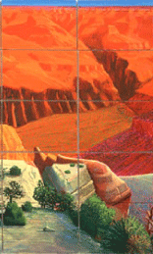
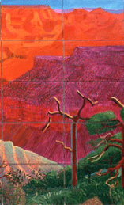
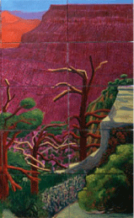
David Hockney

Slide 21
David Hockney

Slide 22
Brice Marden

Slide 23
Brice Marden

Slide 24
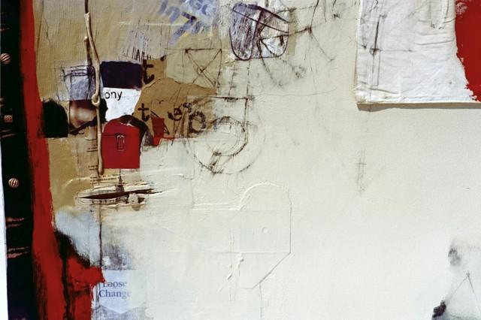
Katherine Chang-Liu

Slide 25
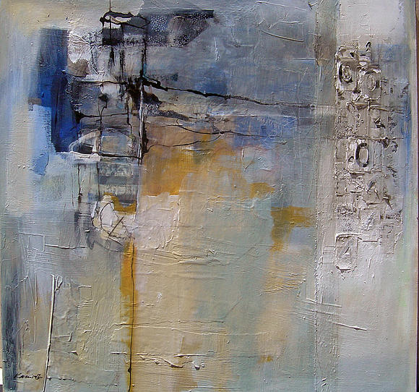
Katherine Chang-Liu

Slide 26
How my work has Evolved
Introduced watercolors into the brush work of my landscape painting
Using colors to create mood
Brush control is still the focus, strive for naturalness and spontaneity
Layering with colors
Collapse the traditional deep space to shallow space
The marriage of landscape painting with calligraphy by using layering & collages
Lost and Found

Slide 27
Using colors to create Mood (FLM)
Traditional
Watercolor

Slide 28
Examples of Ink and watercolor Brushwork (FLM)
Traditional
Watercolor

Slide 29
Used Color to create Mood (FLM)

Slide 30
Used Colored lines (FLM)

Slide 31
Used Colored Lines (FLM)

Slide 32
Stacking Multiple Canvases (FLM)

Slide 33
Layering, Collage, Lost and Found (FLM)

Slide 34
Used Only Calligraphy Collage (FLM)

Slide 35
Used Collage (FLM)
Before
After

Slide 36
Conclusion
There is much to learn from Chinese and Non-Chinese artists
More to explore by using collage calligraphy in my work
Interested in creating different textures
Experiment with colors and layers
Experiment with multiple panels

